Slide 1
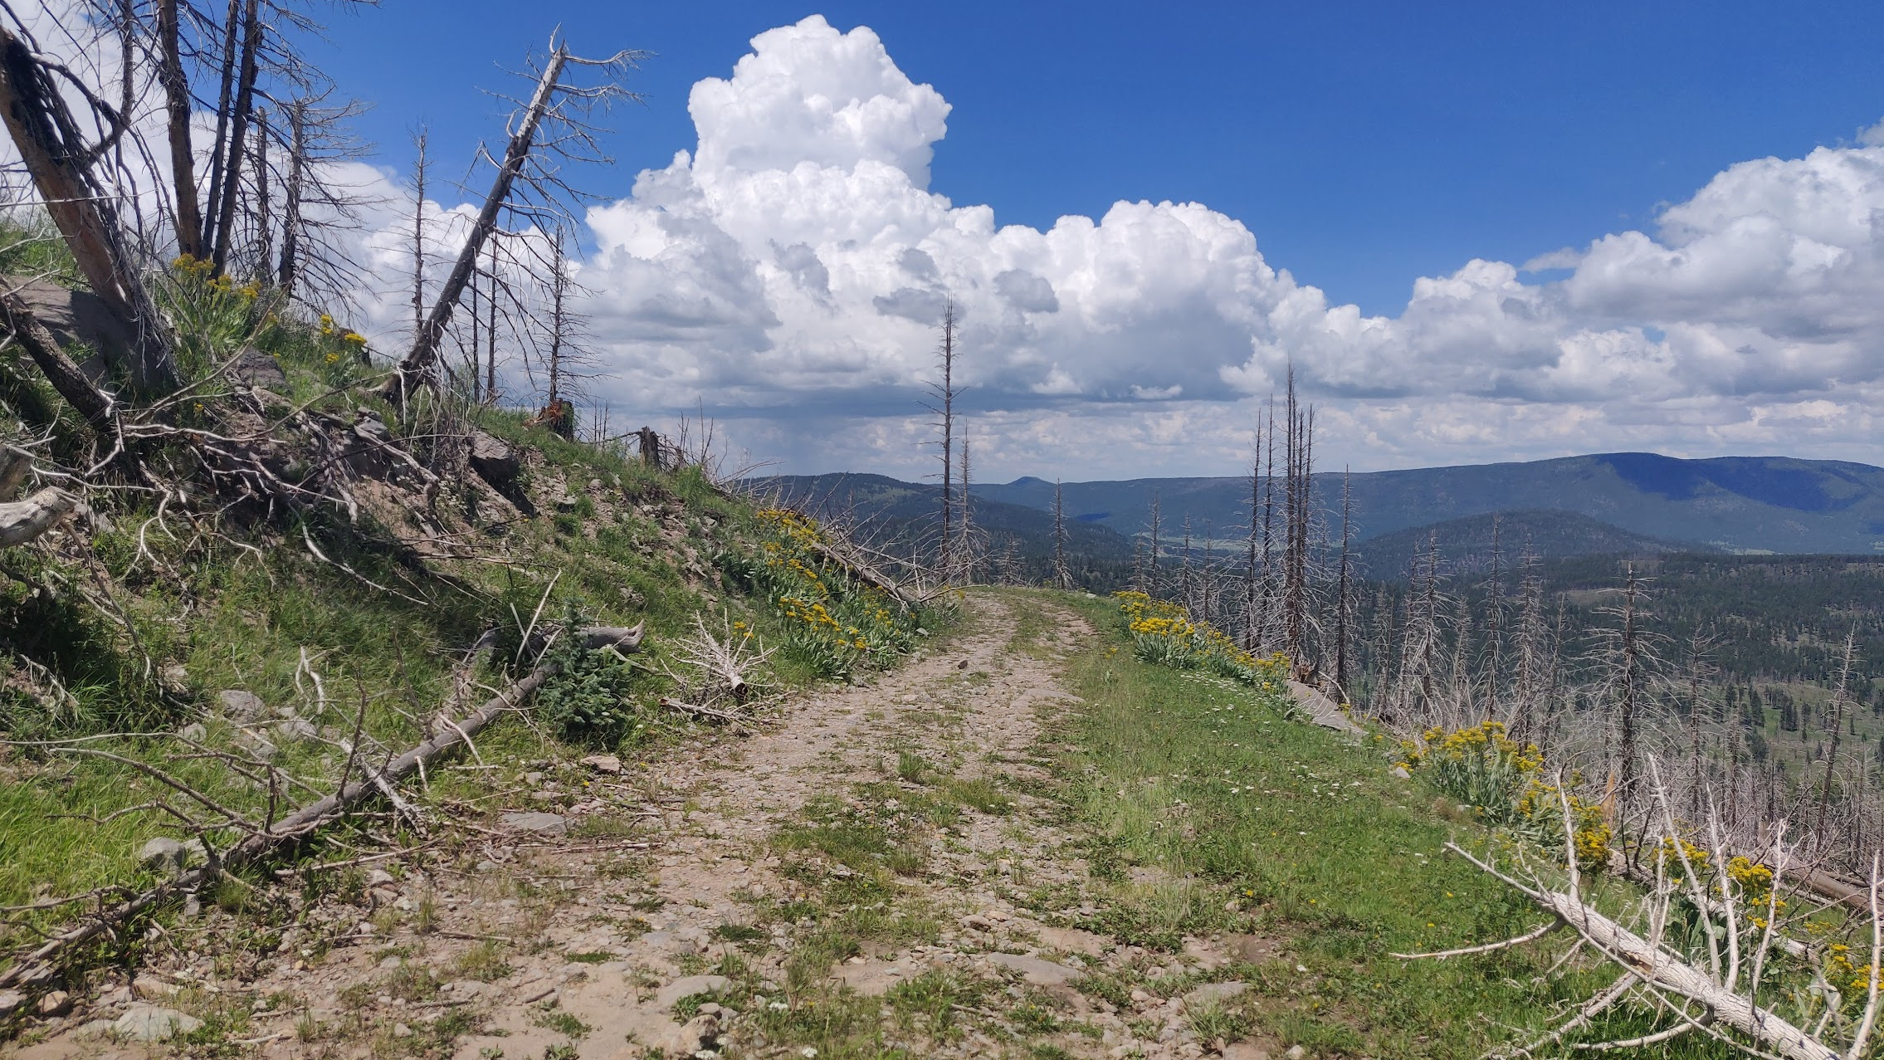
Communicating the Role of Water in New Mexico’s Ecosystems to the Public
Will Crockett, UNM Physics and Astronomy

Slide 2
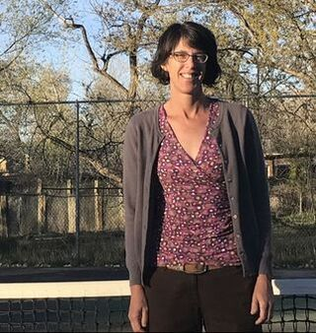
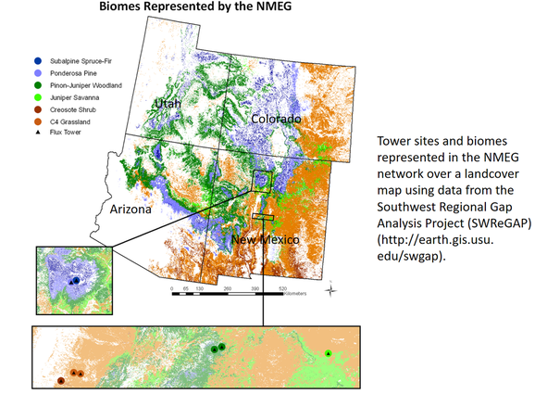
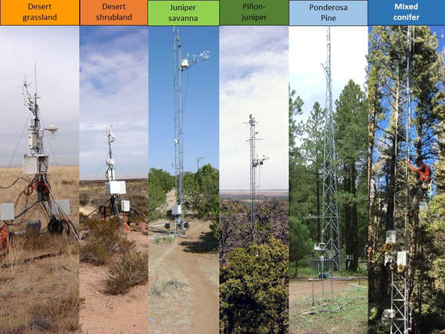
Studying New Mexico’s Ecosystems- The Litvak Lab
http://www.litvaklab.org/new-mexico-elevation-gradient.html

Slide 3
The Litvak Lab has generated an amazing amount of data
http://www.litvaklab.org/new-mexico-elevation-gradient.html

Slide 4
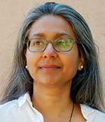
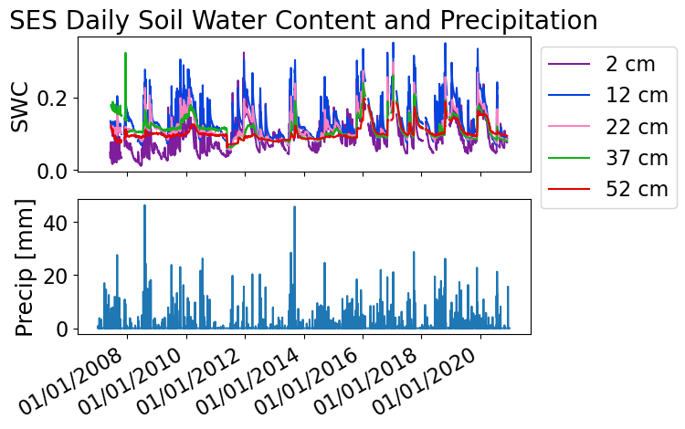
Work with Dr. Mousumi Roy

Slide 5
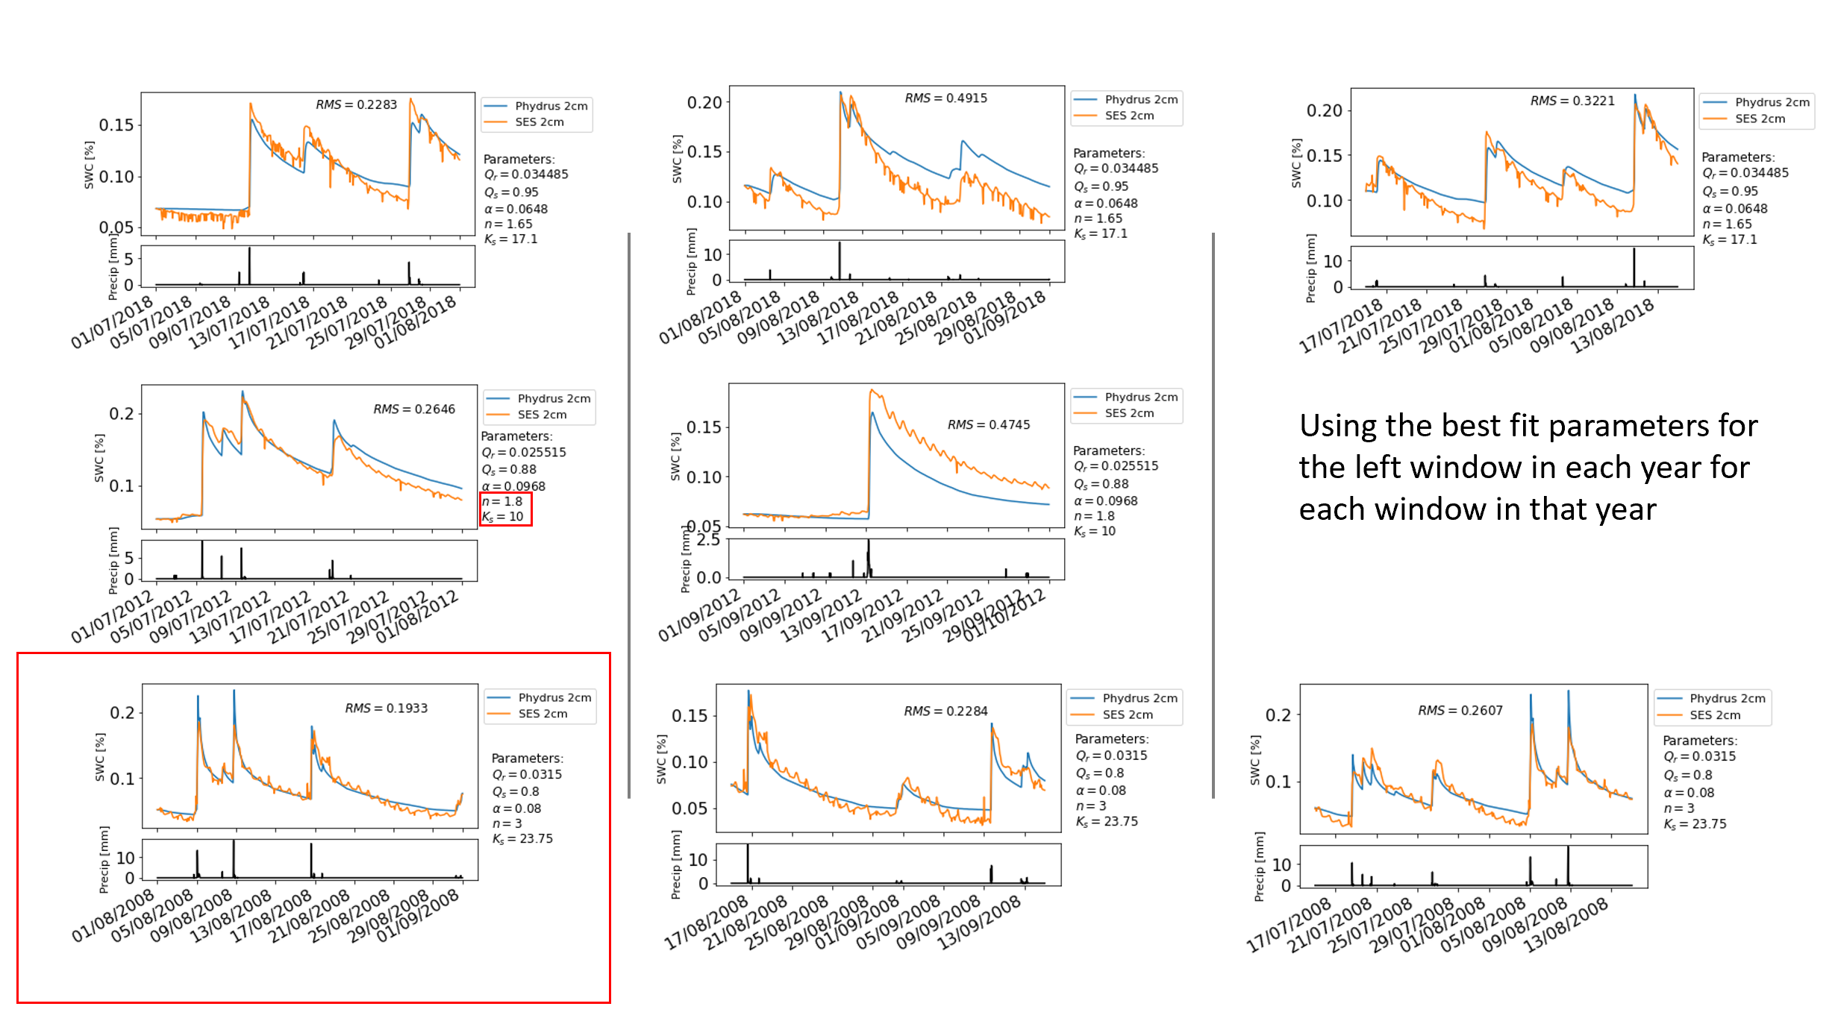
Using the Richards Equation to Model Soil Hydrology

Slide 6
How do we communicate this with the public?

Slide 7
How do we communicate this with the public?

Slide 8
How do we communicate this with the public?

Slide 9
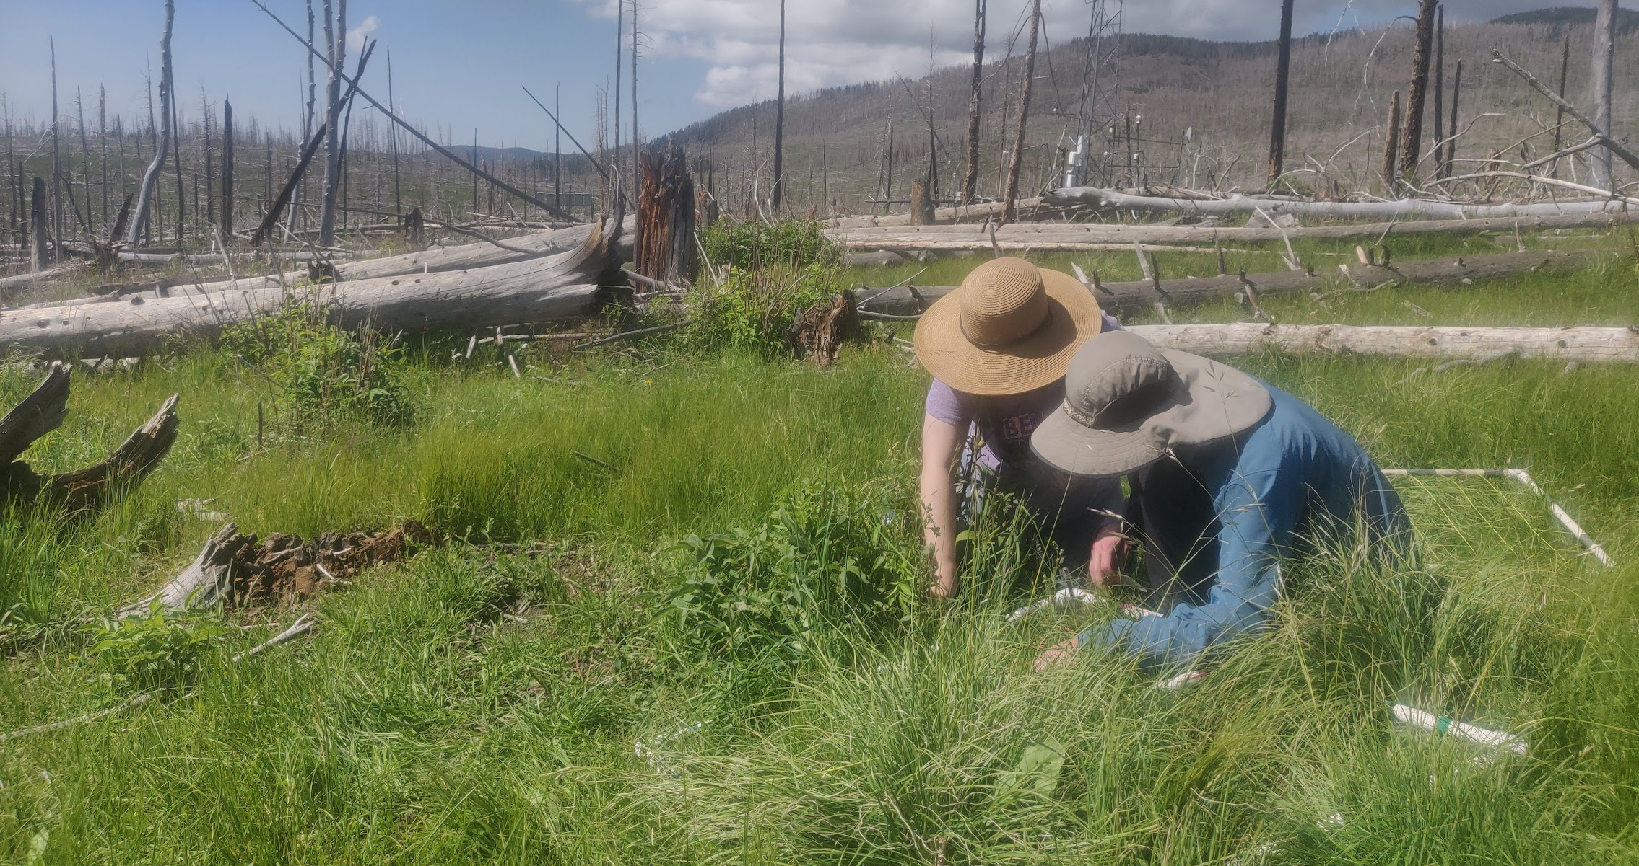
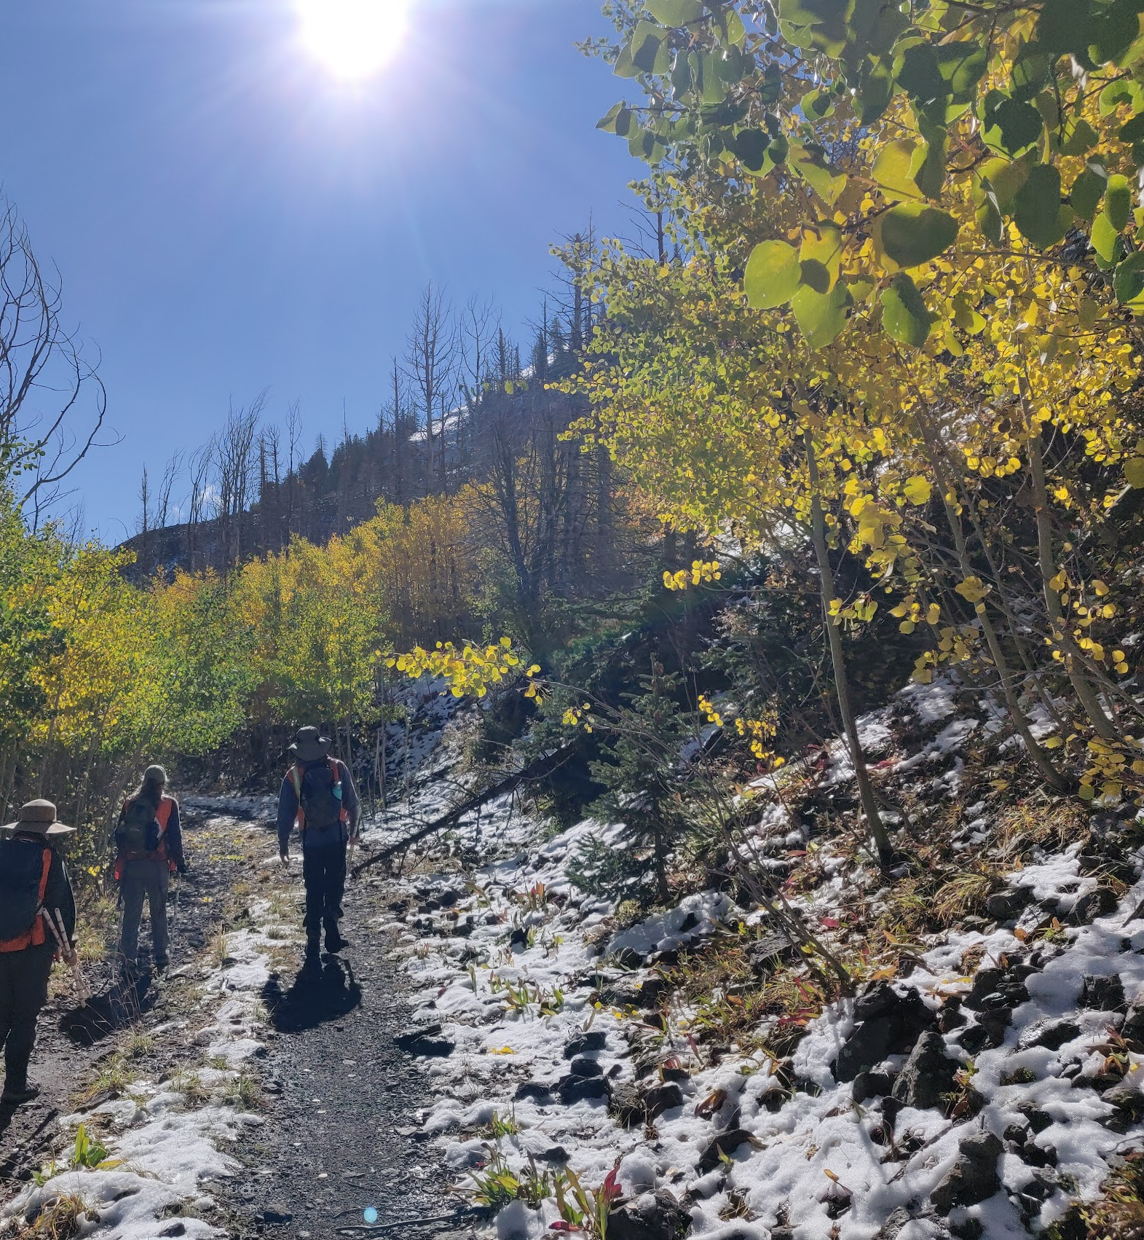
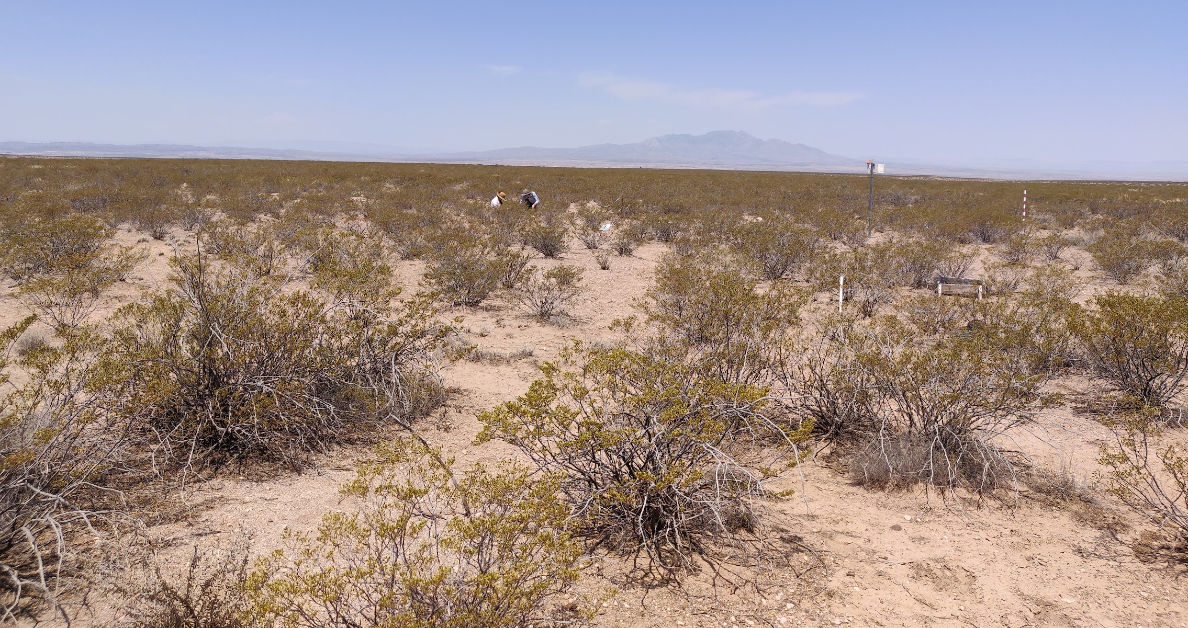
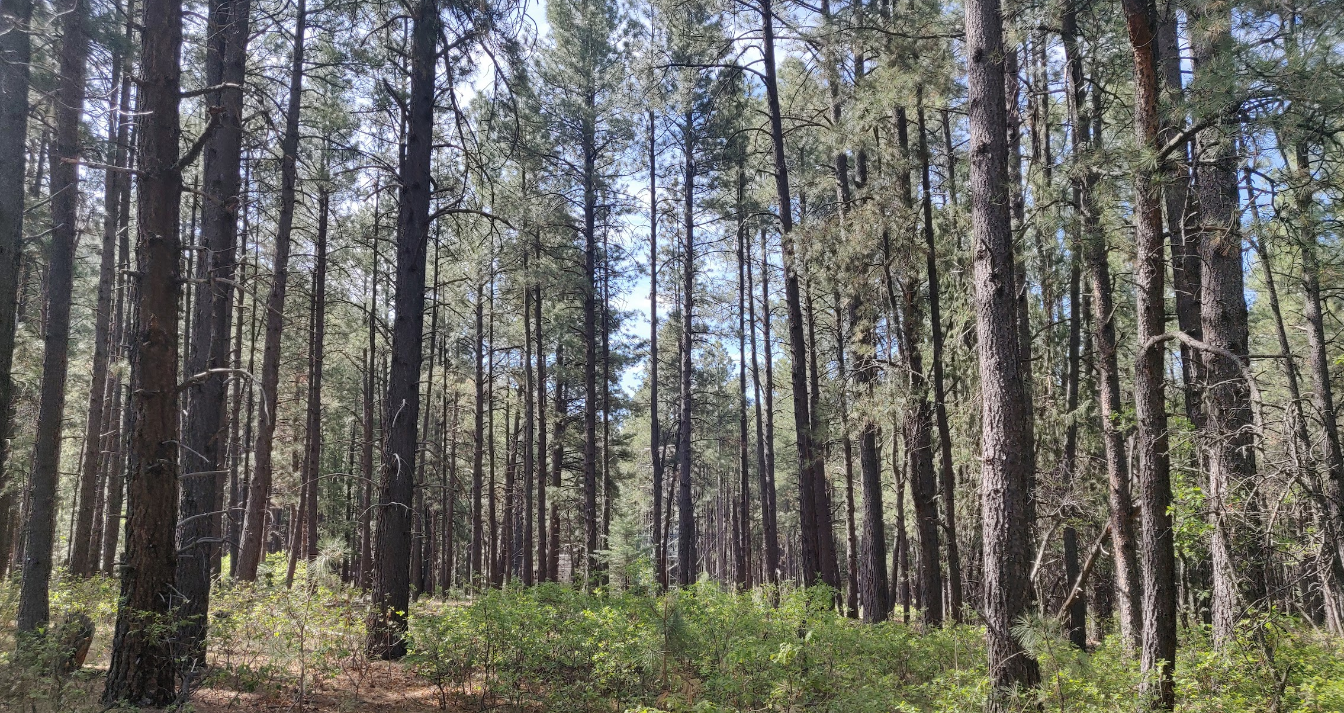
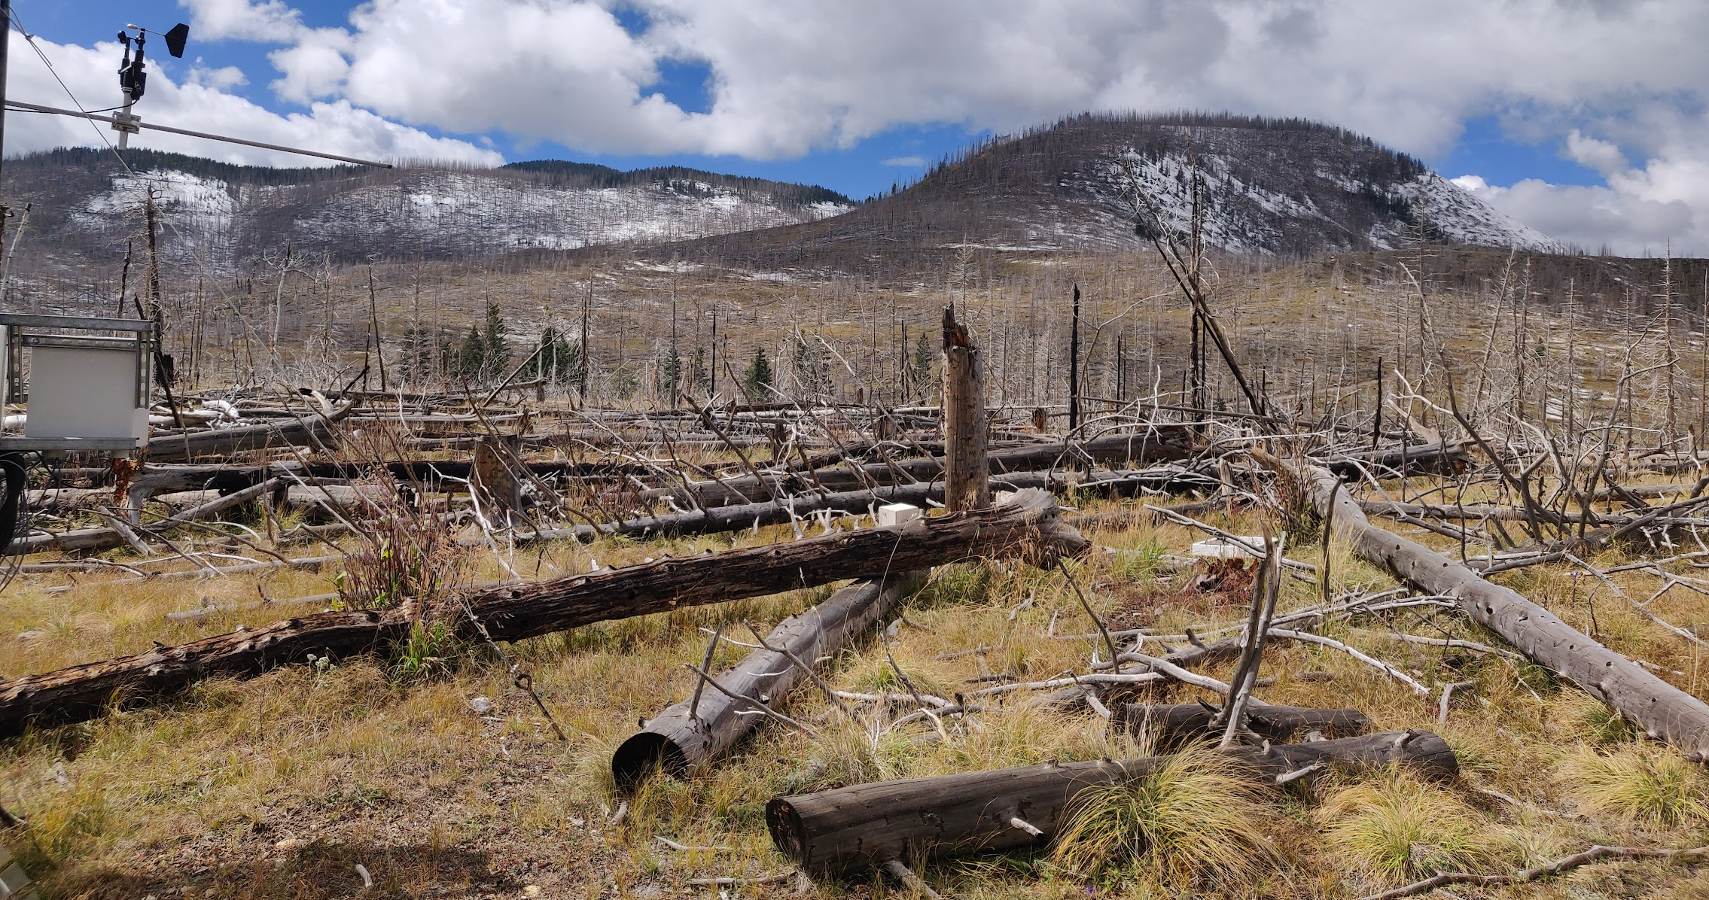
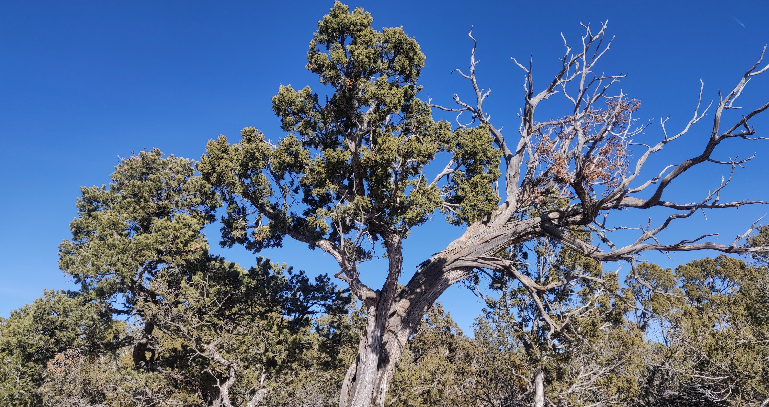
Giving a reason to care

Slide 10
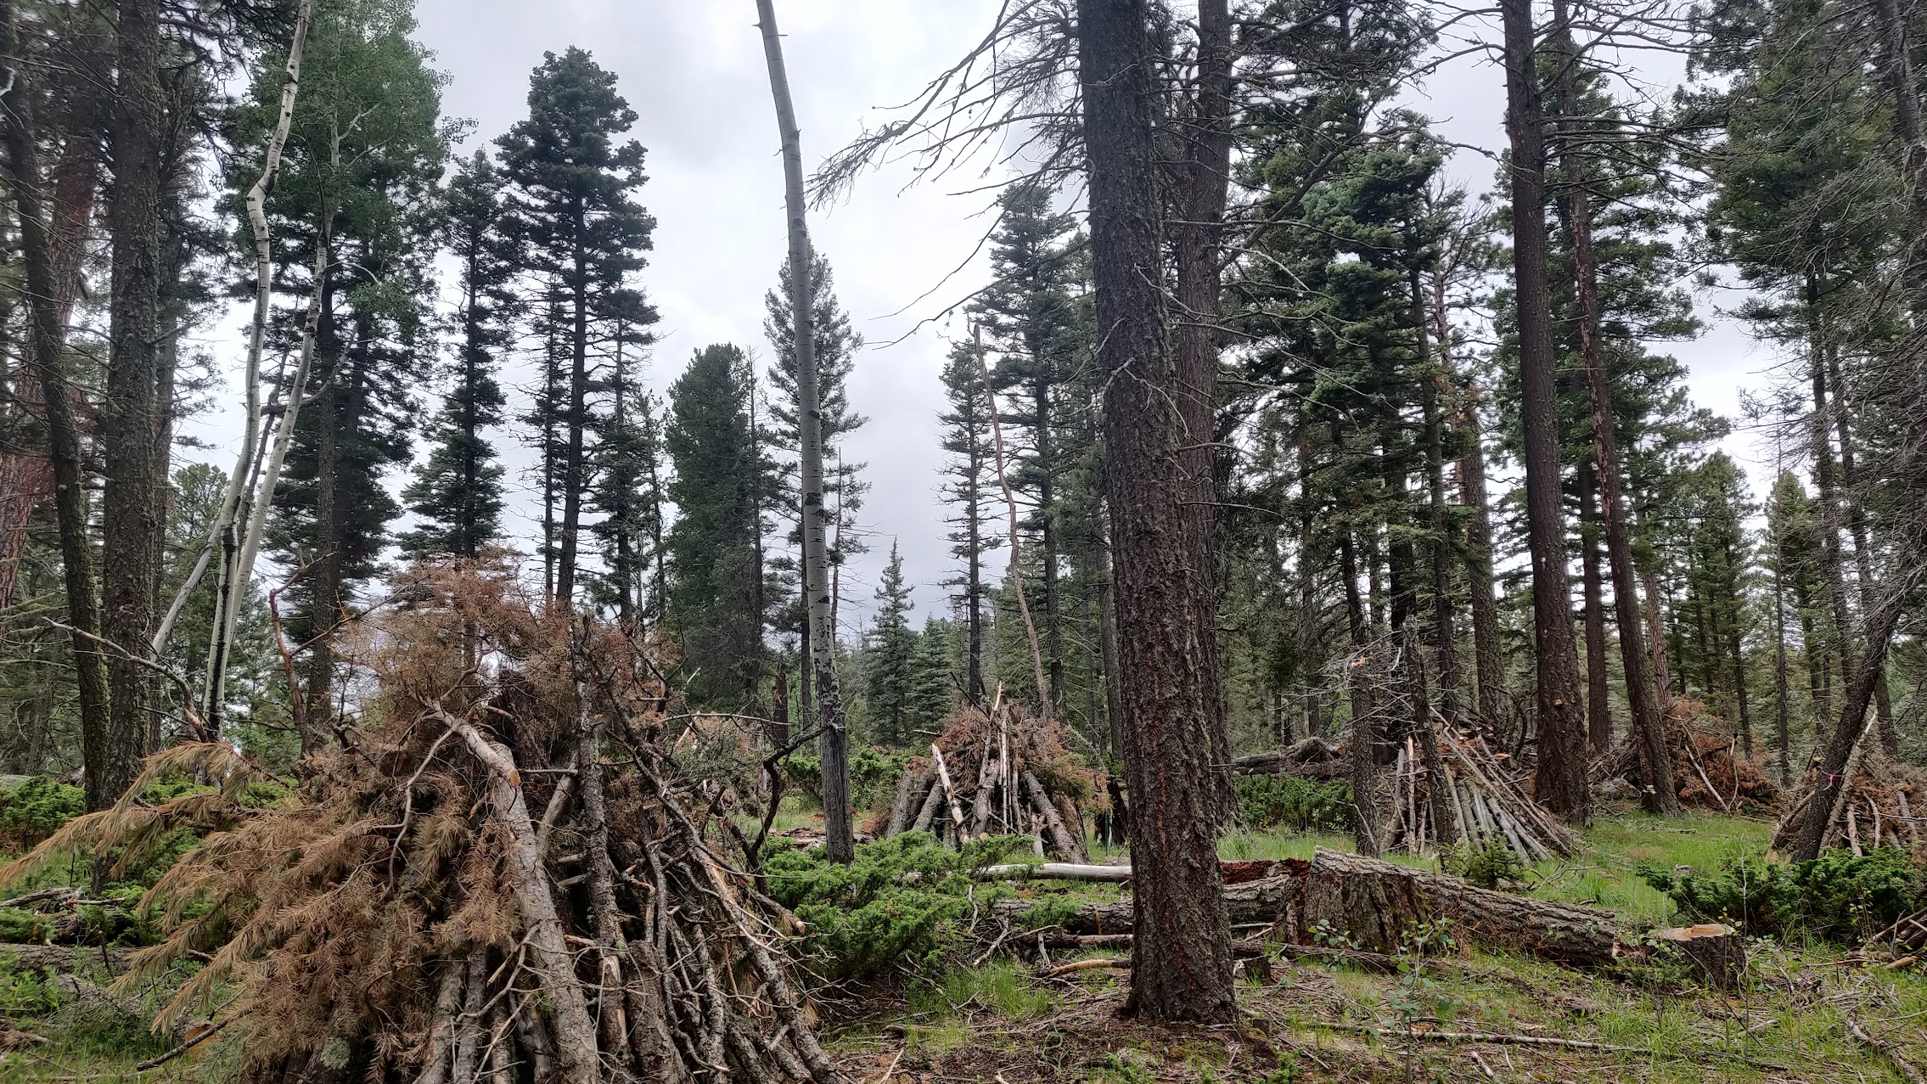
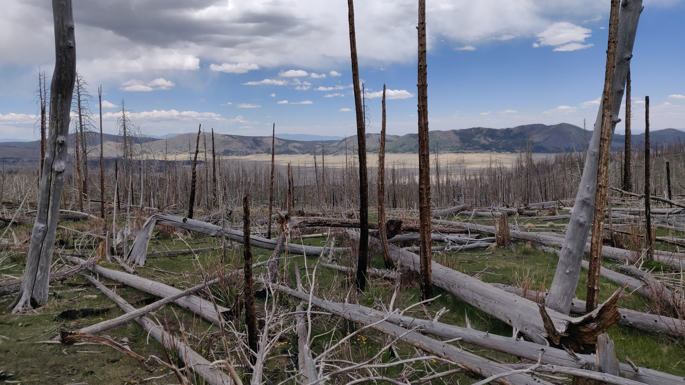
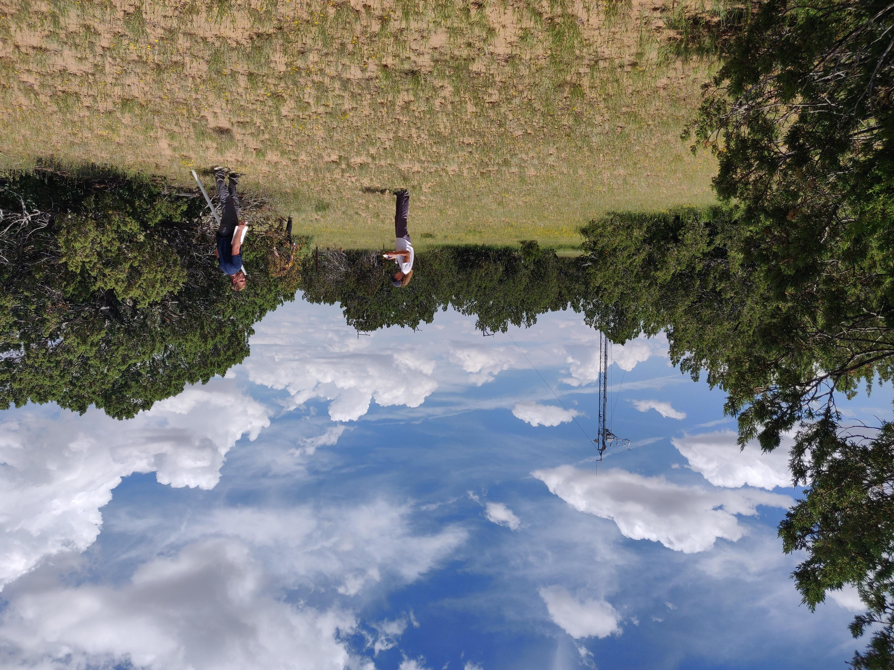
Project- Video Series sharing Information about the sites

Slide 11
Video Project
https://youtu.be/Im1URkep_Lg

Slide 12
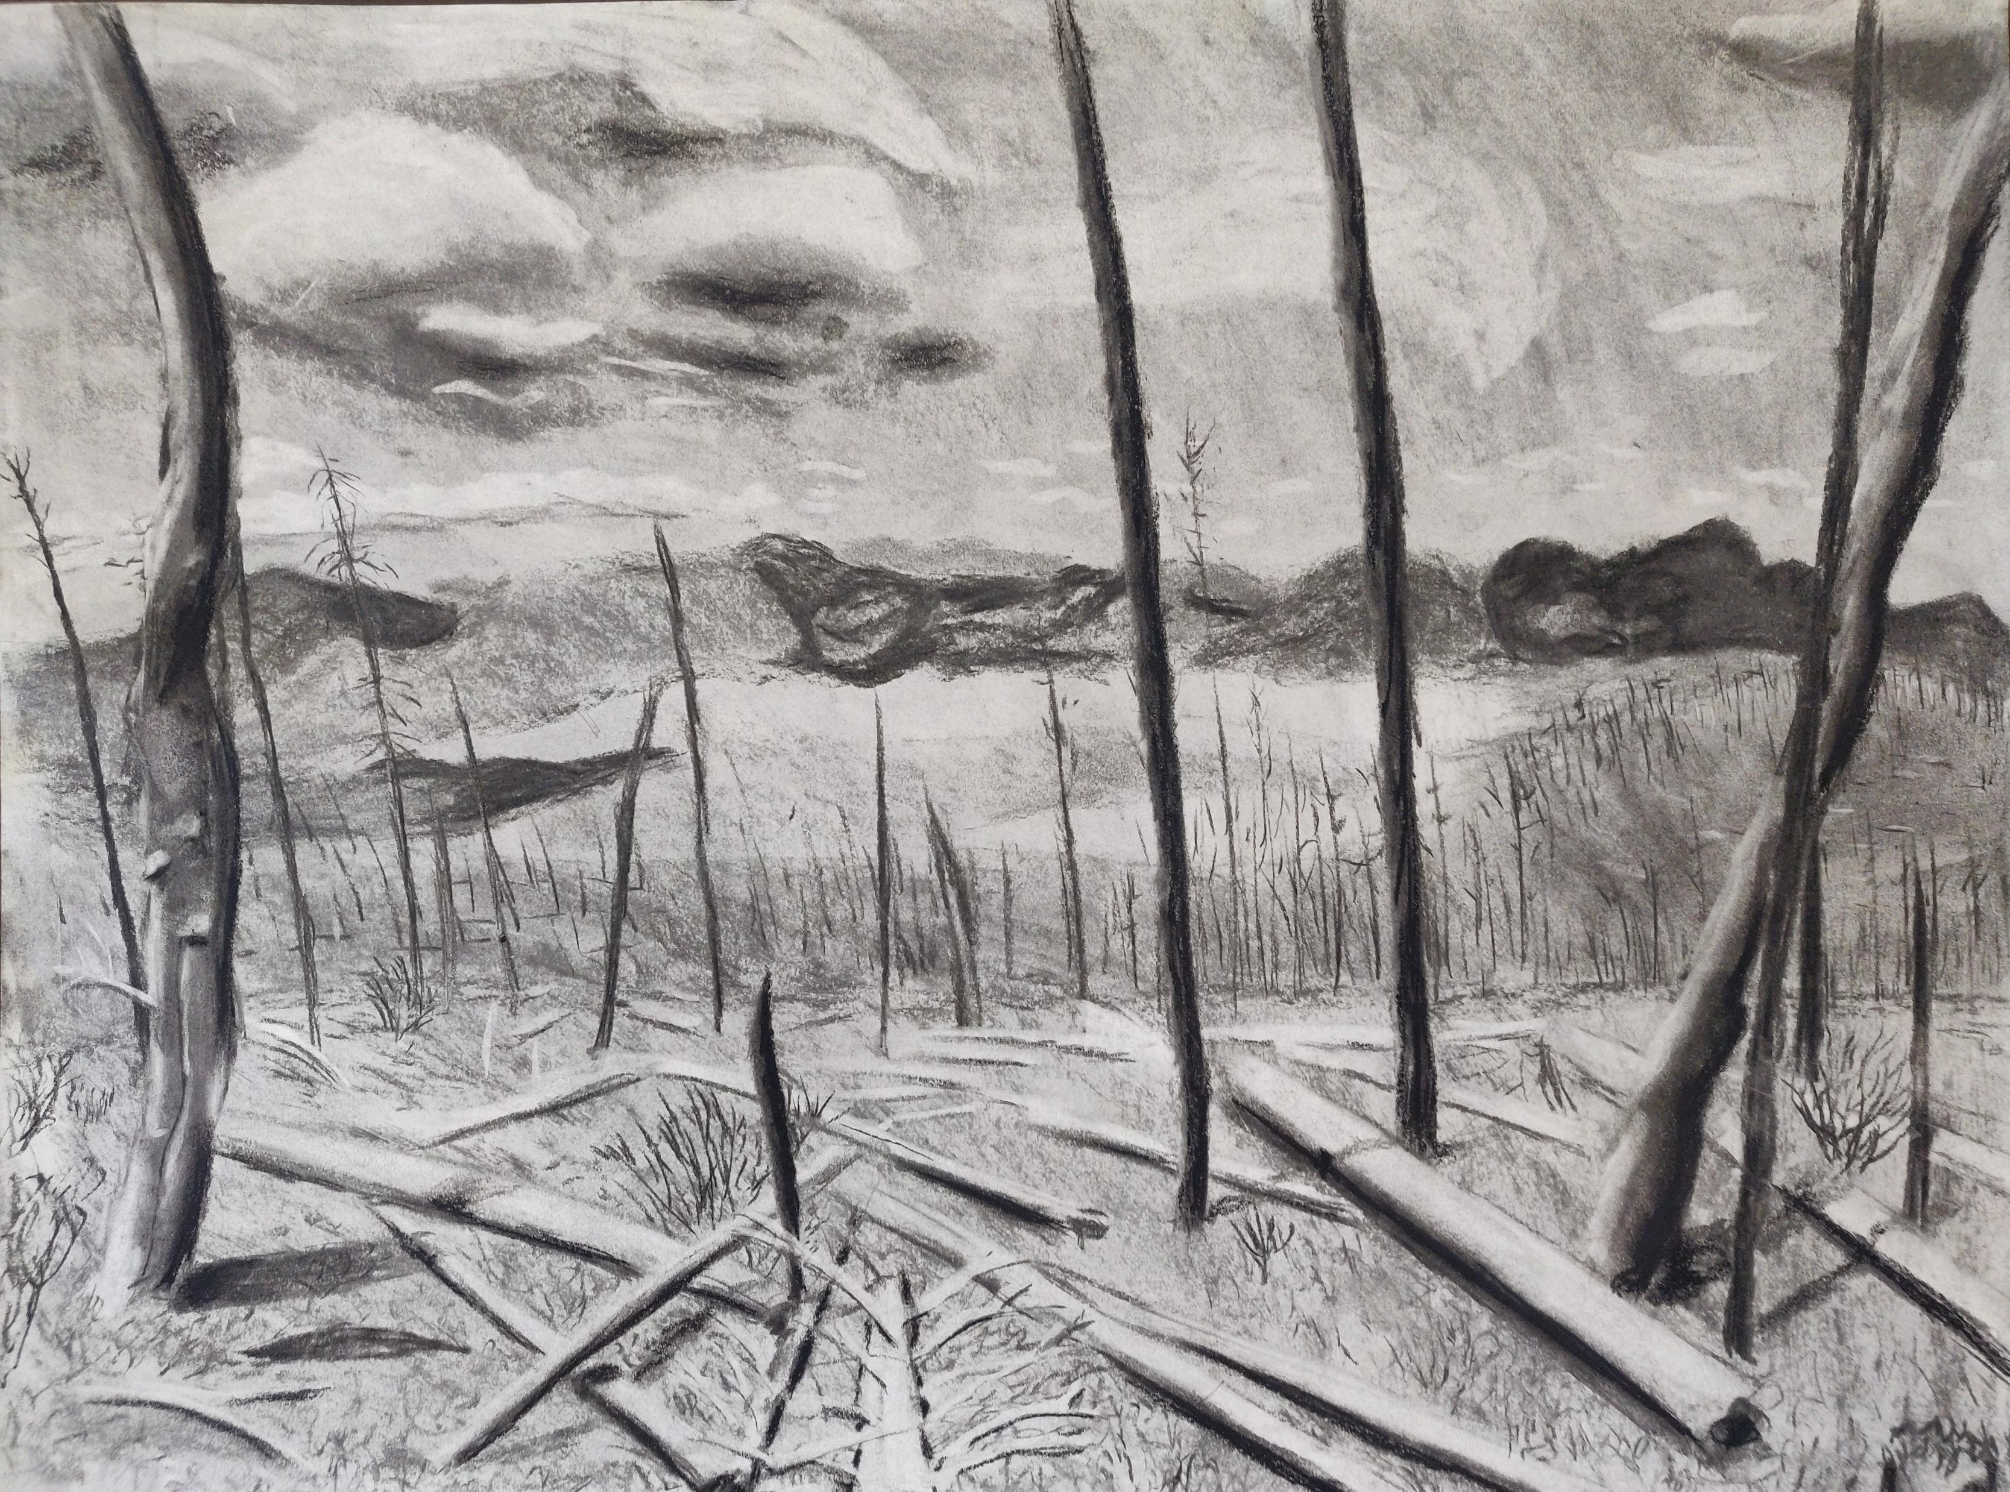
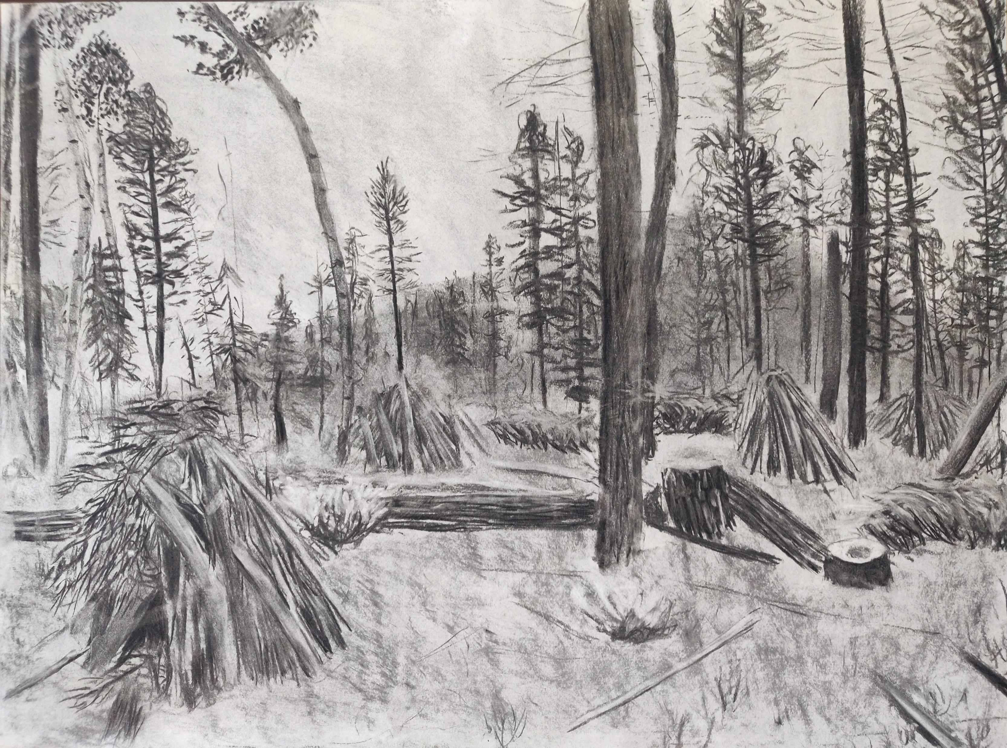
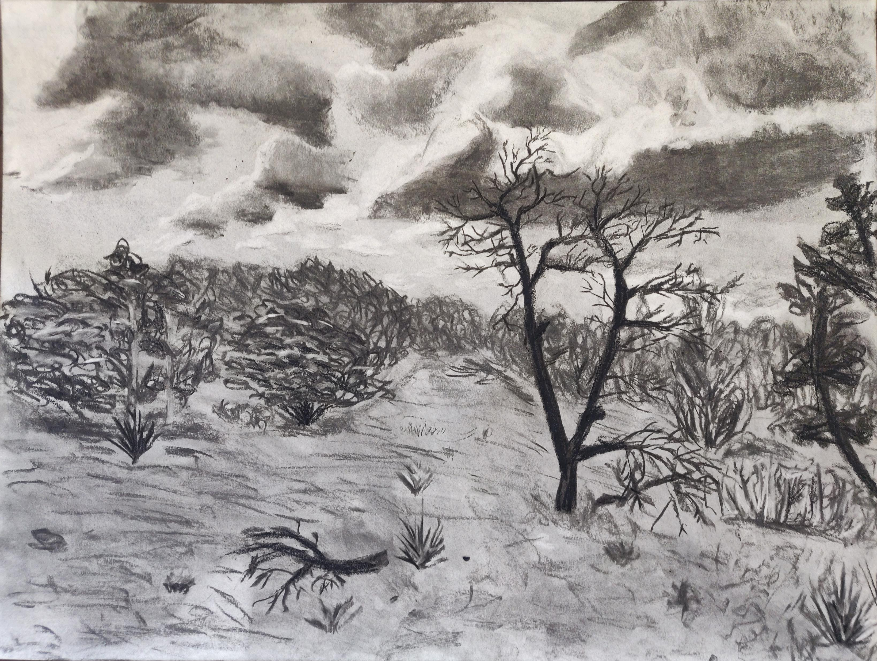
Finished Drawings

Slide 13
Thank you!

